Slide 1
CSC 495 – Classifying Pitch Type using Machine Learning
Jacob Schuh

Slide 2
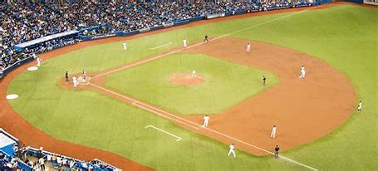
Introduction
My project will be analyzing data from over 2000 pitches from EKU baseball team’s 2022 season to classify the type of pitch thrown

Slide 3
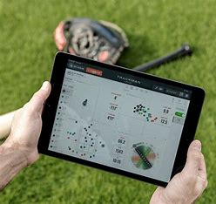
Introduction
Many college and professional baseball teams use a system called Trackman
Trackman’s software gives reports with comprehensive ball tracking data
Requires someone to go through pitch by pitch and correctly determine the pitch type

Slide 4
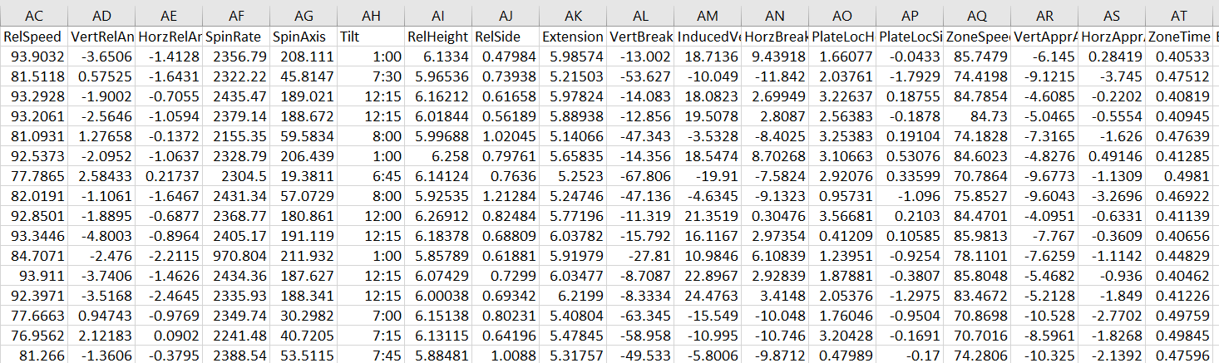
Data
The data used for this project was collected using the Trackman Software
Collected from 7 different games between February - May 2022
Dataset includes 2160 pitches

Slide 5
Data
RelSpeed
VertRelAngle
HorzRelAngle
SpinRate
SpinAxis
Tilt
RelHeight
RelSide
Extension
VertBreak
InducedVertBreak
HorzBreak
PlateLocHeight
PlateLocSide
ZoneSpeed
VertApprAngle
HorzApprAngle
ZoneTime

Slide 6

Data
Normalization of data
Randomization of data
70/30 Training Testing Split

Slide 7
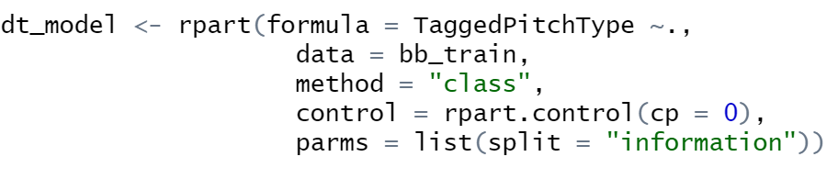
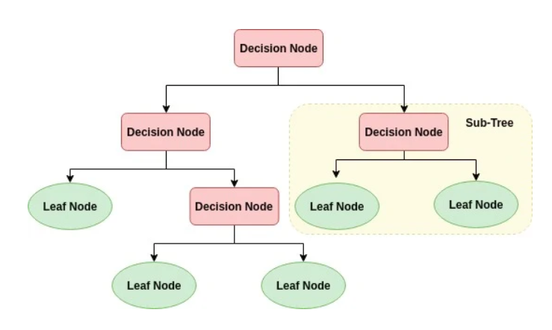
DecisionTree

Slide 8
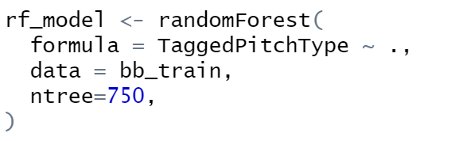
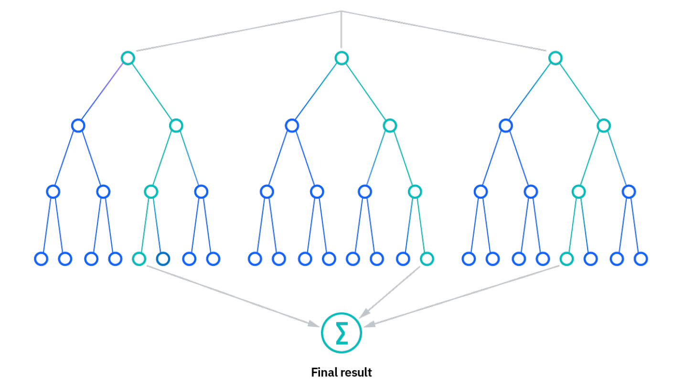
RandomForest

Slide 9
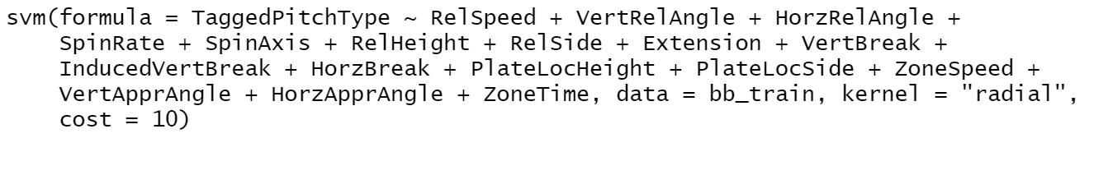
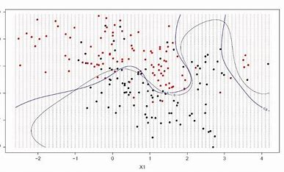
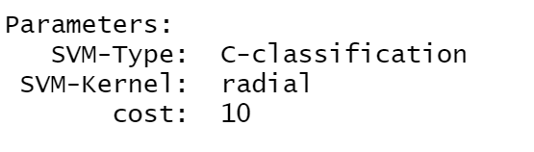
Support Vector Machine

Slide 10
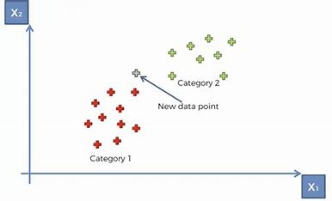

K-Nearest Neighbors

Slide 11
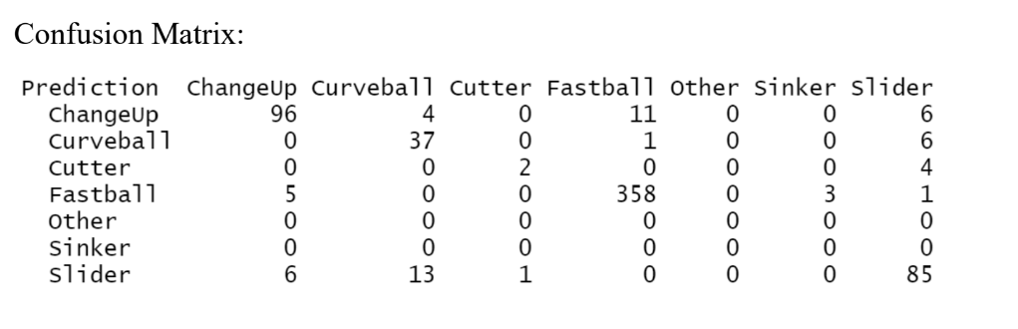
DecisionTree Results
Accuracy : 0.9045
95% CI : (0.8791, 0.9262)
No Information Rate : 0.579
P-Value [Acc > NIR] : < 2.2e-16

Slide 12
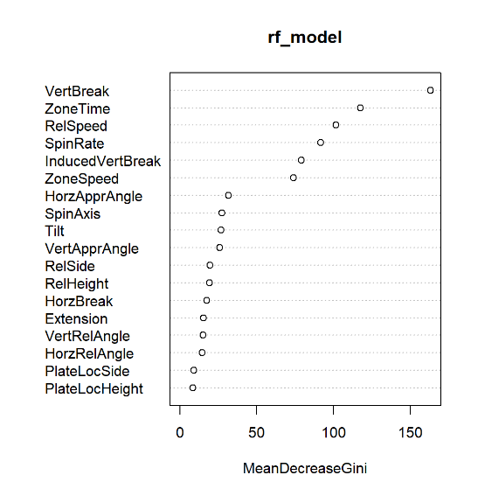
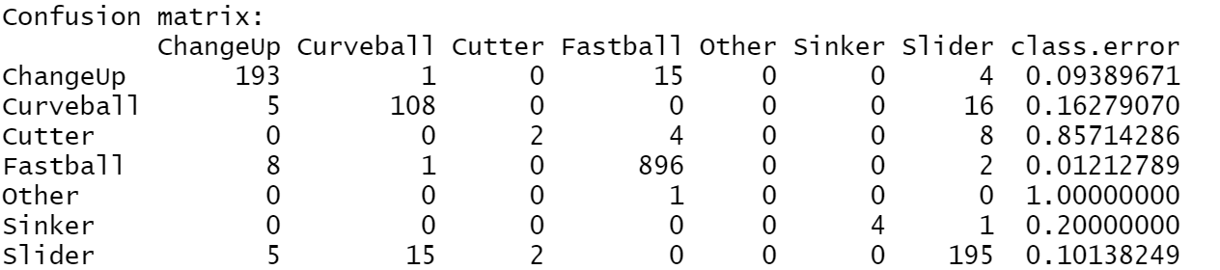
RandomForest Results
Accuracy:
> accuracy
[1] 0.9671362
> error
[1] 0.05477308

Slide 13
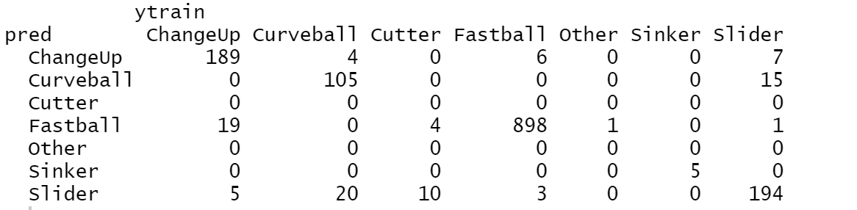
Support Vector Machine Results
Accuracy: 0.943662

Slide 14
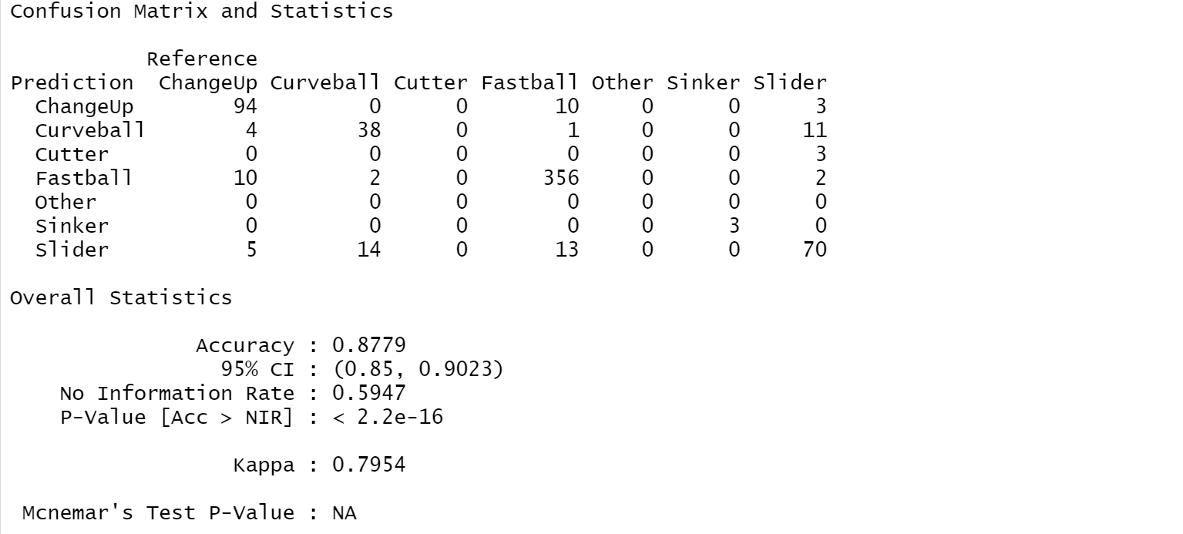
K-Nearest Neighbors Results

Slide 15
Results
Model | Accuracy
Random Forest | 96.7%
Support Vector Machine | 94.3%
K Nearest Neighbors | 87.8%
Decision Tree | 90.5%

Slide 16
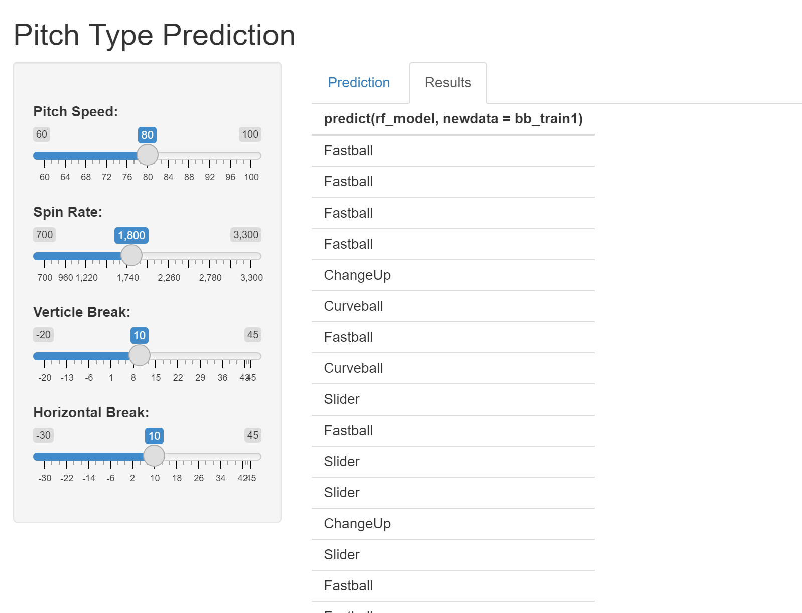
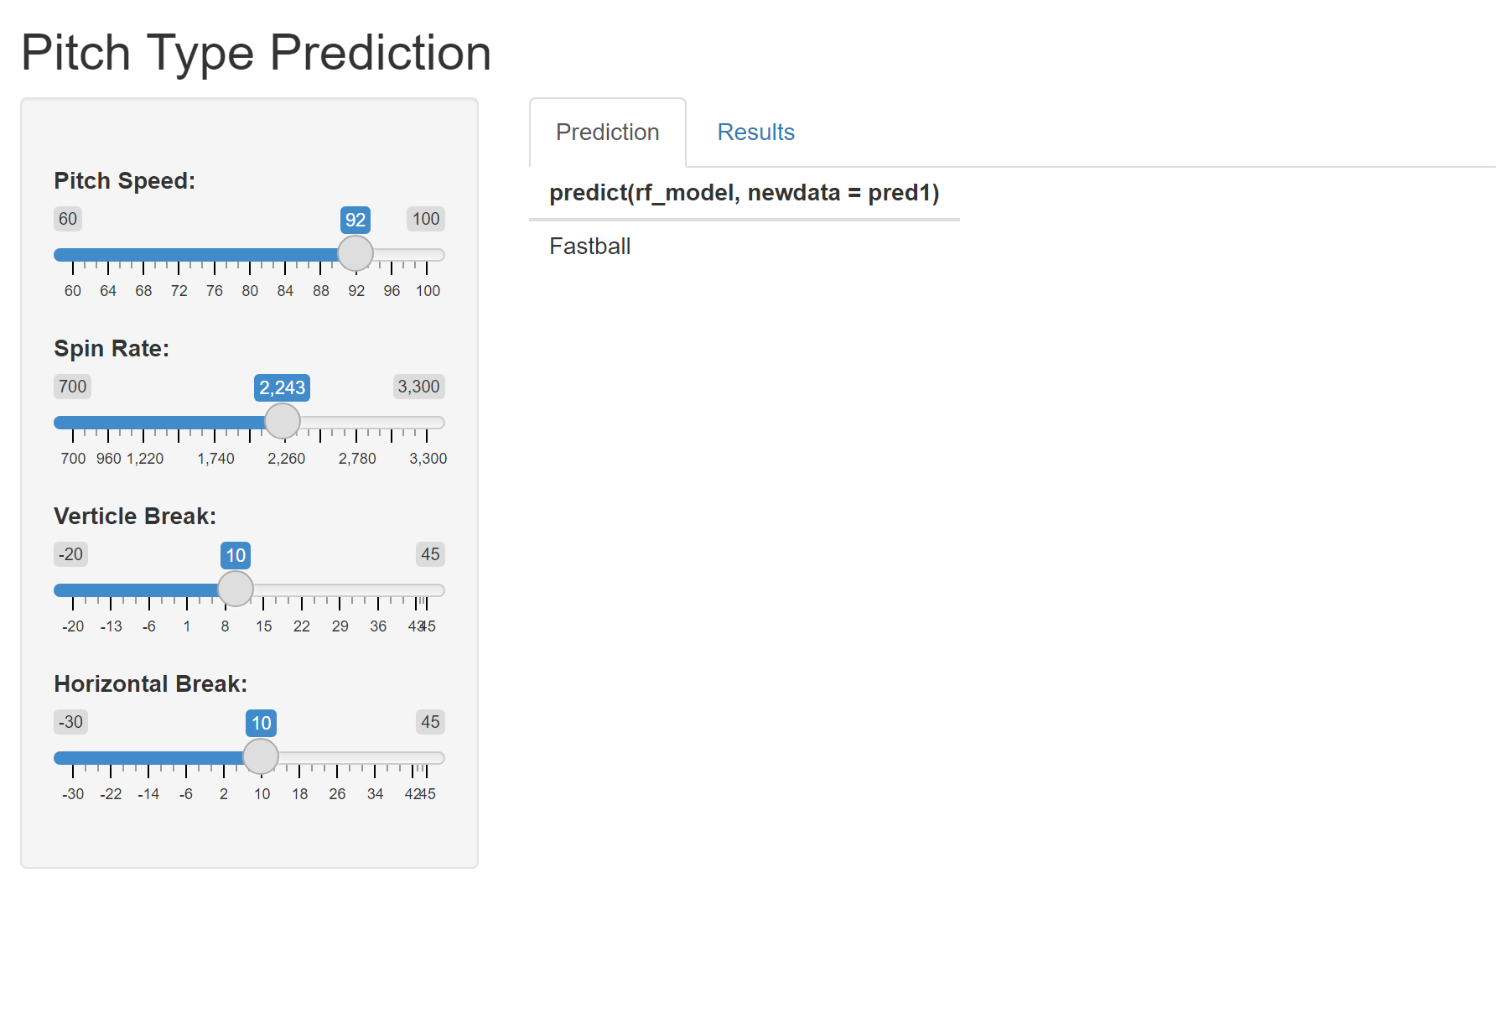
Interactive App

Slide 17
Conclusions
I have analyzed data from over EKU baseball games to classify the type of pitch thrown with 96.7% accuracy
In future work with this project, I would like to work with a dataset that I had more confidence in its accuracy, and a larger dataset as well
Machine Learning models worked incredibly well to predict the type of each pitch thrown and with slightly better training could realistically replace the human work of inputting a pitch

Slide 18
References
Breiman, L. (2001), Random Forests, Machine Learning 45(1), 5-32.
Breiman, L (2002), “Manual On Setting Up, Using, And Understanding Random Forests V3.1”, https://www.stat.berkeley.edu/~breiman/Using_random_forests_V3.1.pdf.
Rong-En Fan and Pai-Hsune Chen and Chih-Jen Lin (2005), “Working Set Selection Using the Second Order Information for Training SVM” https://www.csie.ntu.edu.tw/~cjlin/papers/quadworkset.pdf
Ripley, B. D. (1996) Pattern Recognition and Neural Networks. Cambridge.
Venables, W. N. and Ripley, B. D. (2002) Modern Applied Statistics with S. Fourth edition. Springer.
Breiman L., Friedman J. H., Olshen R. A., and Stone, C. J. (1984) Classification and Regression Trees. Wadsworth.

